Slide 1
Game design document
Dungeon – deck of 52 cards with a possible 4 extra.
Room – 4 cards drawn when only one card is left.
Health pool – it starts at and can't go over 20 points. Black cards subtract from it and heart cards add to it.
Toolbelt - I have chosen 6 cards to use in scoundrels game loop. The tools work as ways to take less damage from a room but the usefulness is decreased as you block creatures (you can't block any higher than you previously blocked)
Weapons – diamond cards are attached to the Toolbelt and will be used to decrease damage taken by the player. If a creature is blocked, only strictly lower damage creatures can then be blocked.
Hearts – can restore the health pool
Clubs and spades – creatures that subtract from the health pool but can have some of their damage blocked by diamond cards. Clubs could be special things that apply bleeding or poison which will affect the player by ticking up a counter to death or doing damage for following turns.

Slide 2
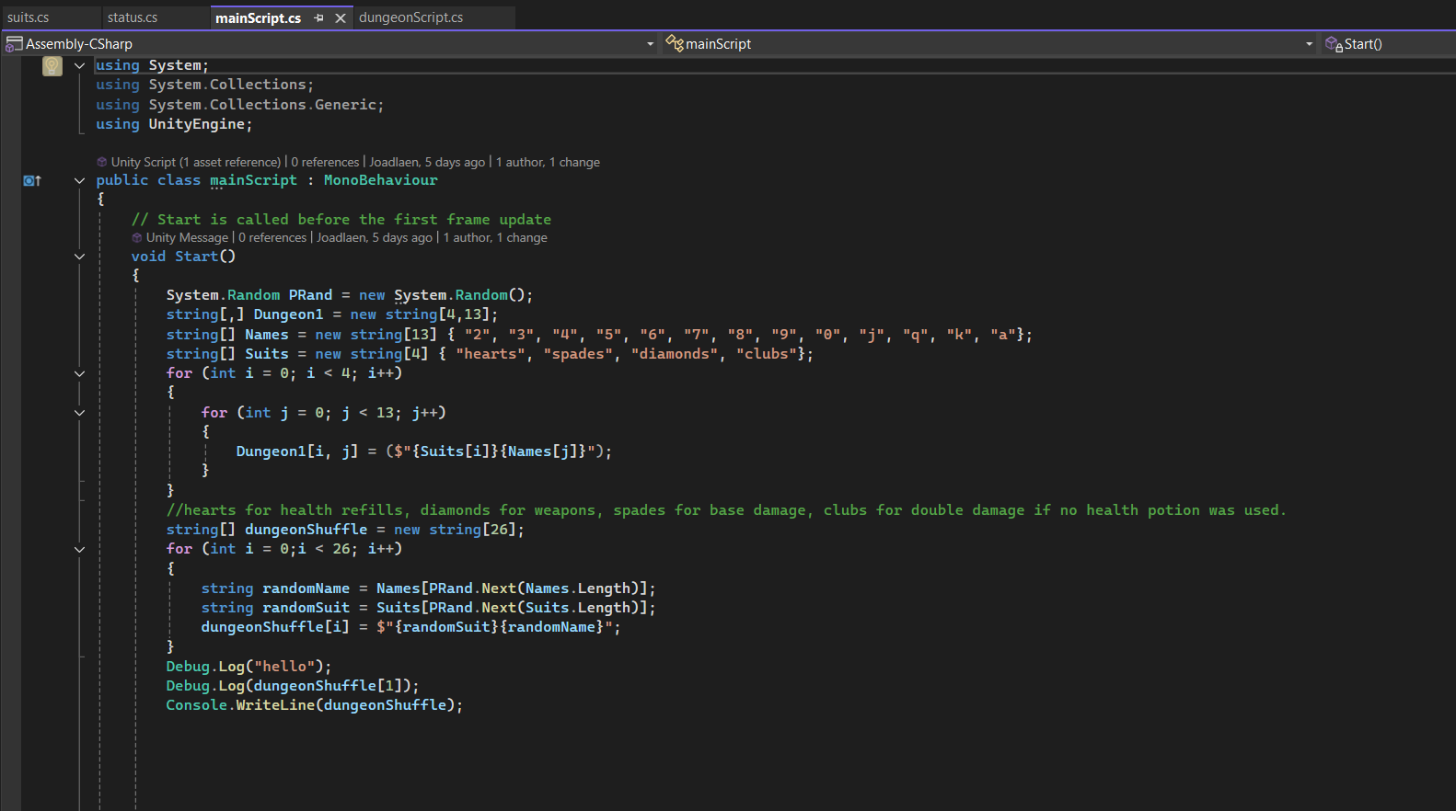
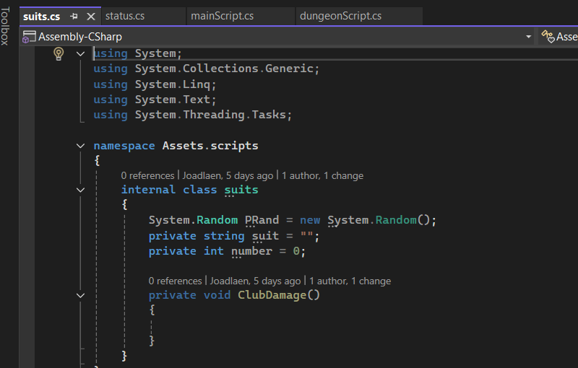
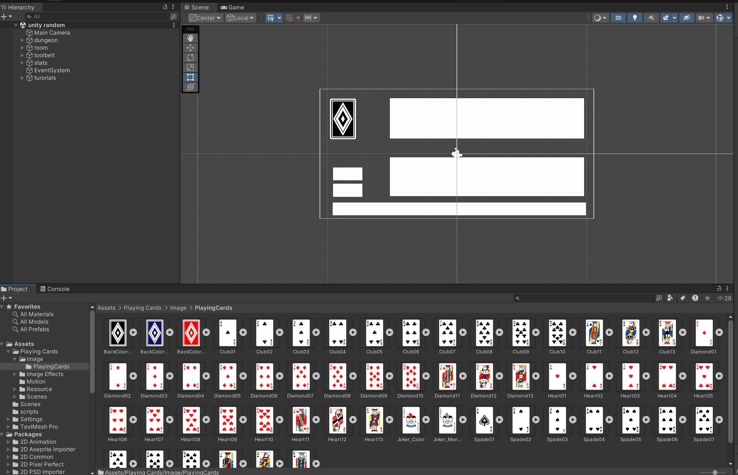
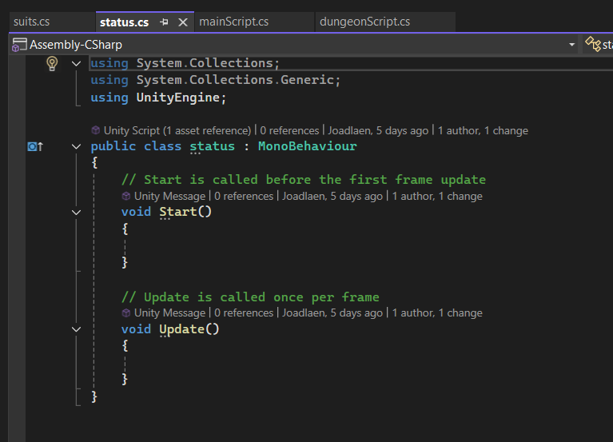
My original plan was to make scoundrel which is a solitaire game. I realised on the 7th of April that it would be too hard to implement the full gameplay loop in the time given. I have as such, decided to pivot to a tactical war game featuring a 4 by 4 grid that you can move 1 of two units to a new space. I am glad that I realised how hard scoundrel would be early enough. I can now pivot to the new game
This game will contain a tank unit that can’t pass through the wall in the centre and a squad of 6 which can.
The random number generator has been incorporated as a d6 for the attacks.

Slide 3
An old project of mine was a 2d maze game that required some squares to be blocked to function correctly, I didn’t manage to finish this task until university where I collaborated with another student and we created a Boolean array that could be used to mark wall squares. I have a similar issue with this game and can use the Boolean table to mark the terrain squares for the tanks which can’t pass through them.

Slide 4
Purge the heretic design.
Battlefield - must
4x4 - must
8x8 - could
16x16 - won’t
Tank - could
Squad - must
Enemy - must
Firearms - should
Simple tracking AI - should
Random AI - must
Menace style AI - could
D6 - must
D3 - could
Charges and melee- won’t
Advancing - could
Cover - could
Auto generating battlefield - could

Slide 5


Must
4x4 Battlefield – sprites, two cover pieces, two objectives
Squad – specific and separate sprite that can move one square in any orthogonal direction
Enemy – unit checks for player, chooses a path, moves in a direction. Repeat
D6 – random number generators, might allow for advance.
Simple or random AI – the enemy unit chooses a path based on the square it occupies. Random number generator. If it sees player after movement, it attempts to attack. It could also choose a random square next to it whilst advancing
It will move to c3 if it is on d3 or c4, it gives sight into a1, a2, b1 and b2.
Same vice versa. The player can move in similar ways

Slide 6
Could
Larger battlefield – a project I made a while ago involved a procedurally generated a grid of pictureboxes in visual studio. I can implement that into the game to make battlefields of multiple sizes and change the scale of the sprites.
Tank piece – random number generator on what piece to move for AI, button for player to switch which piece to move
Menace style AI – for a fixed board, seeing what sequences of moves can be made and whether the AI or the player wins. This is based on the AI used to become a perfect tic tac toe player. The failing moves are removed and if no winning moves are found down a path,
Advancing – an extra button or key-prompt could be used to move two squares each turn but disable shooting for that turn
Cover mechanics – if an enemy is diagonally in sight of the player they can make an attack, if cover is next to the squares, the save value is increased. This can be achieved by tagging the sprites and checking adjacent squares to this diagonal path. If any of them are tagged as cover, they provide the
Randomly generating battlefield – randomly generates cover then checks to see if there is are at least two pathways between the objective corners, this would be useful for a larger battlefield, so I don't have to make maps for every size of battlefield.

Slide 7
Functions:
Main function:
Generates battlefield tiles and cover tiles
Receive key prompts:
Movement is "M":
Calls squad movement function
If squad isn't available, call tank movement function
Shooting is "F":
Calls shooting function
Squad movement function.
Spacebar calls tank movement function if tank is still in operation
Tank movement function is the same but spacebar calls squad movement function
Q calls Random number generators for an advance.
Random number generators
Shooting function
Movement function for tank:
F calls shooting function
Movement function for squad:
F calls shooting function
Objects:
Stats class:
Movement
Toughness
Save
Wounds
range
Accuracy
Strength
Armour penetration
damage
Arrays:
Battlefield array(required) - shows where the cover tiles and other items that could be added go. String array
Random:
D6(required)
Battlefield(possibly)

Slide 8
Grid
Nested for loop to create coordinates.
Instantiate a sprite at each coordinate point
Teleport objective markers to their respective positions
Teleport player pieces to their respective positions
Teleport cover pieces to their respective positions
Shoot functions
For loop for hits
Random number above the accuracy score
For loop for wounds (the number of hits above the accuracy score)
Random number above the wounding score
For loop for armour saves (the number of wounds above the wounding score)
Damage is armour saves below armour score taken away from object's health

Slide 9
09/04/25
I have streamlined my design and have decided to start a new project in unity. The idea for this is to have the numbers on the number pad or a collection of letter keys that correspond to orthogonal and diagonal directions. They will also have a button to roll an advance, which will work differently to the standard game. Advance will have a probability to move twice the standard distance, which is one square.

Slide 10
23/04/25
I have decided to tweak the method in which the player moves as the original was a bit cumbersome. I have chosen to use orthogonal directions only using the standard WASD layout. Spacebar can be used to cycle which piece is to be moved. Q and E can be used to move and possibly advance if it can be implemented. F can be used to select units to fire with space being used to cycle between units. Shift could be another method used to advance. An extra key can be used to backtrack.

Slide 11
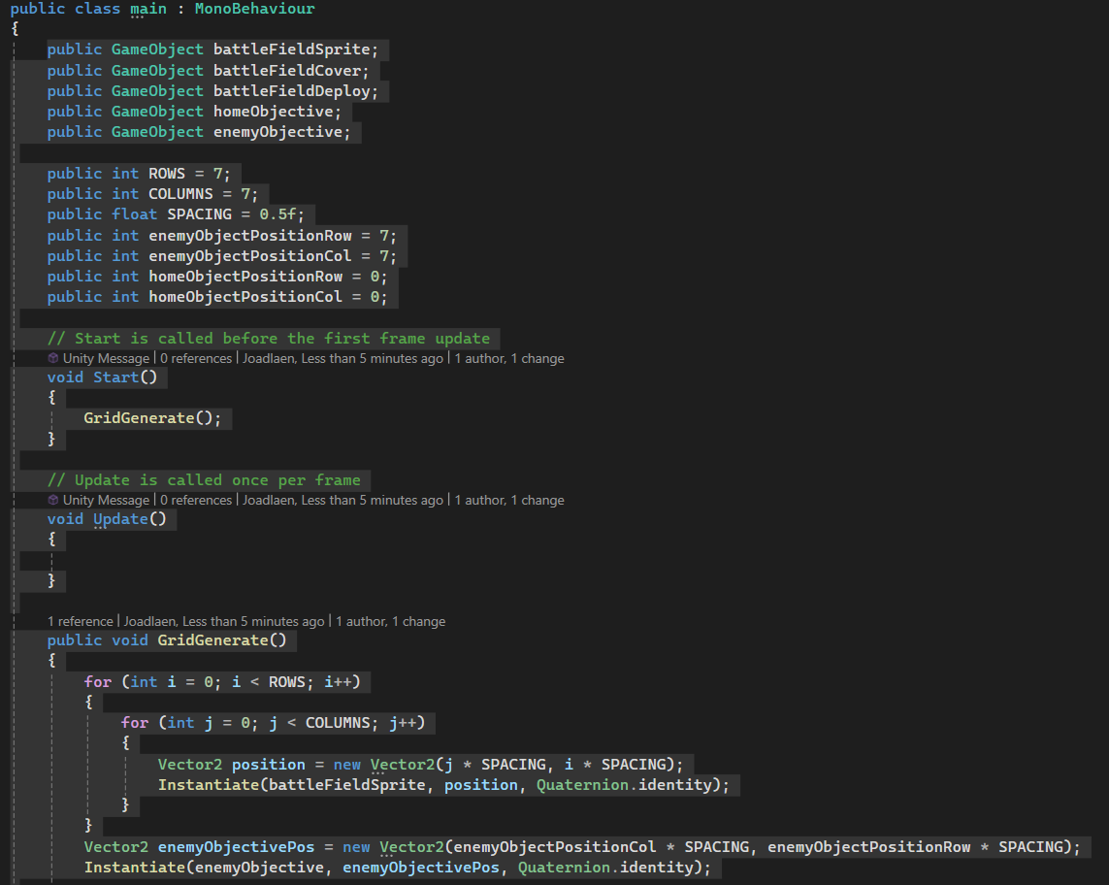
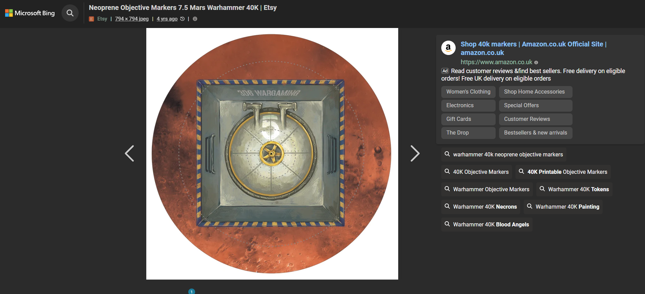
30/4/25
I have researched and begun to implement the randomly generated grid. It uses the nested for loop and instantiates at those specific coordinates
I have also obtained a sprite for objective markers.

Slide 12
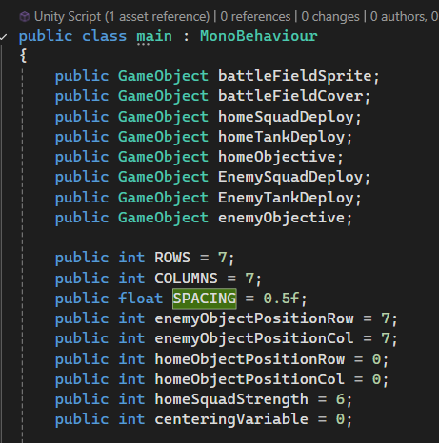
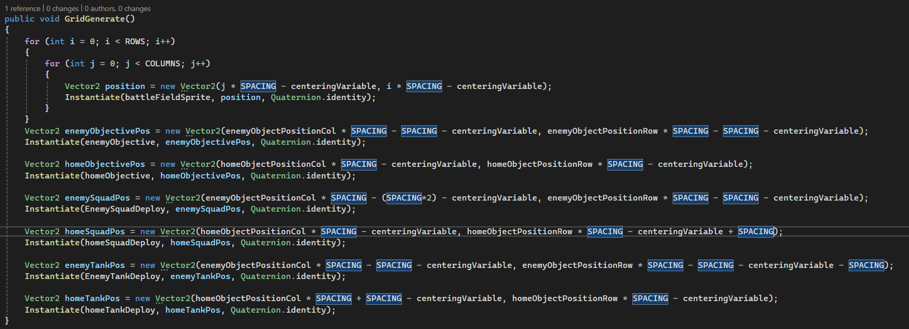
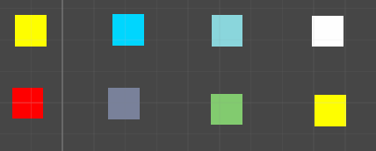
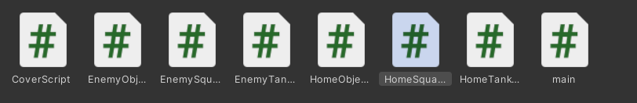
1/5/25
I have improved the grid production and have a clear idea of what to do next. I plan on working on the movement scripts for each piece and the ending scripts for them as well. I have them spawning into the battlefield

Slide 13
5/5/25
Modified plan
Key presses are not intuitive. Clicking on the piece you want to move is more intuitive. Having an event on each movable piece which can bring up a UI which could be a tint over movable or in range squares for movement or shooting. The tint will be a transparent coloured sprite that will have a click event as well which takes the current position of the sprite and the position of the clicked square. A different colour could be added to show and advance which occurs on rolling a 4 or higher from the d6 random number generator. It may be altered to a different number after play testing but it will be a 50% chance to successfully advance an extra square. A similar set of colours could be used for the shooting phase to indicate rapid fire.
Advancing, declaring attacks for some weapons, hits, wounds, damage and saves. A further modification could be to add in feel no pain rolls which would require receiving the damage being dealt. These will need a random to be declared, which could be declared in the main script and new instances could be made whenever it is needed, this could be

Slide 14
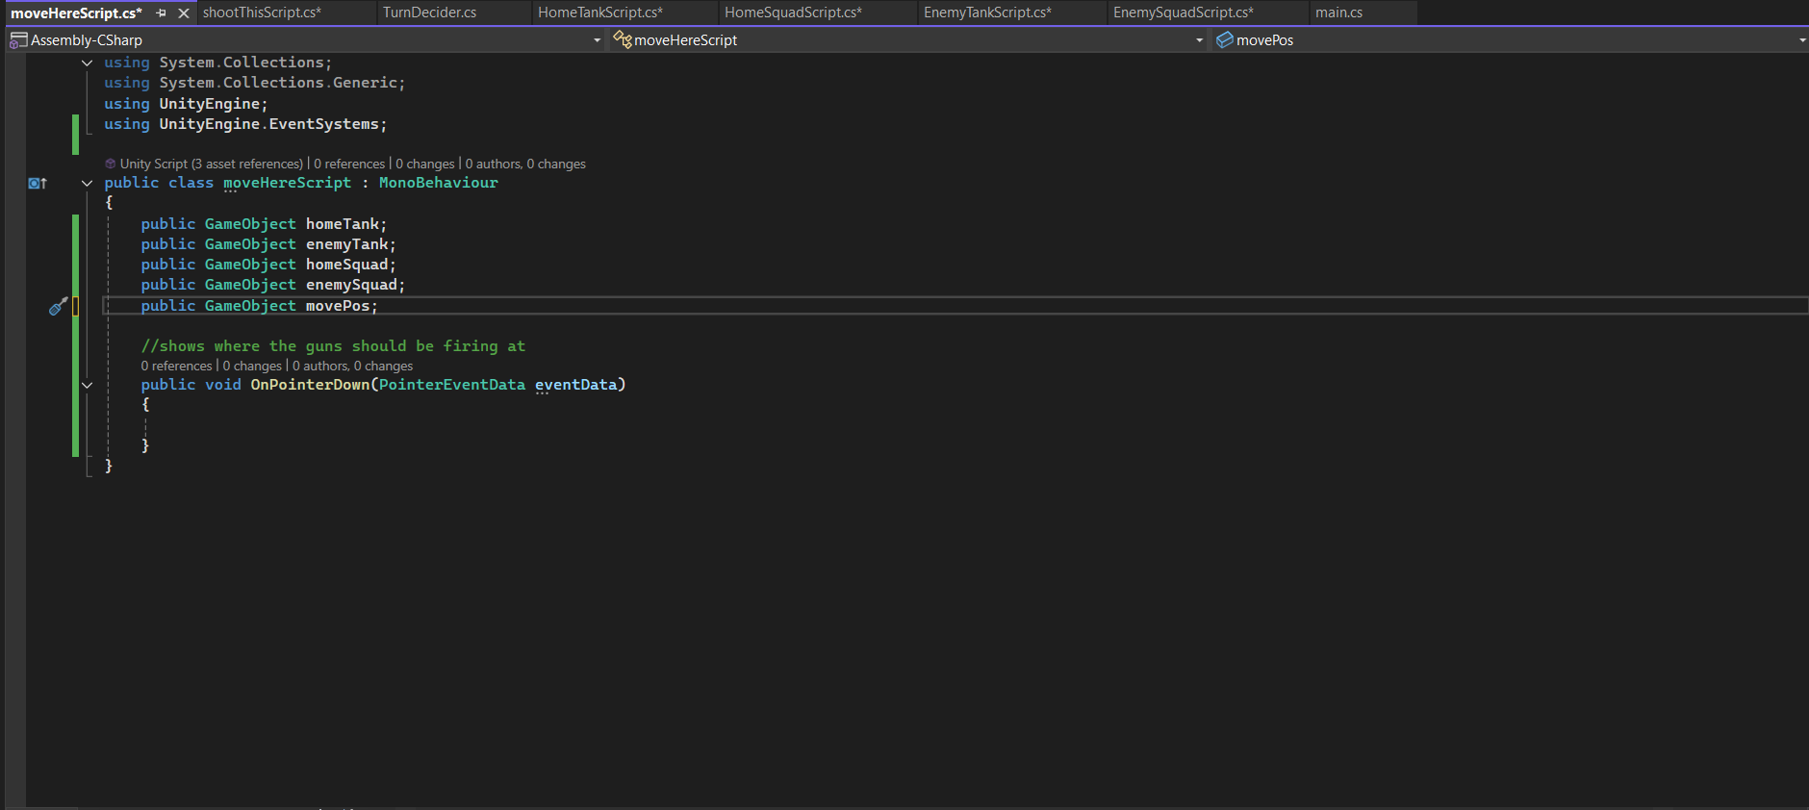
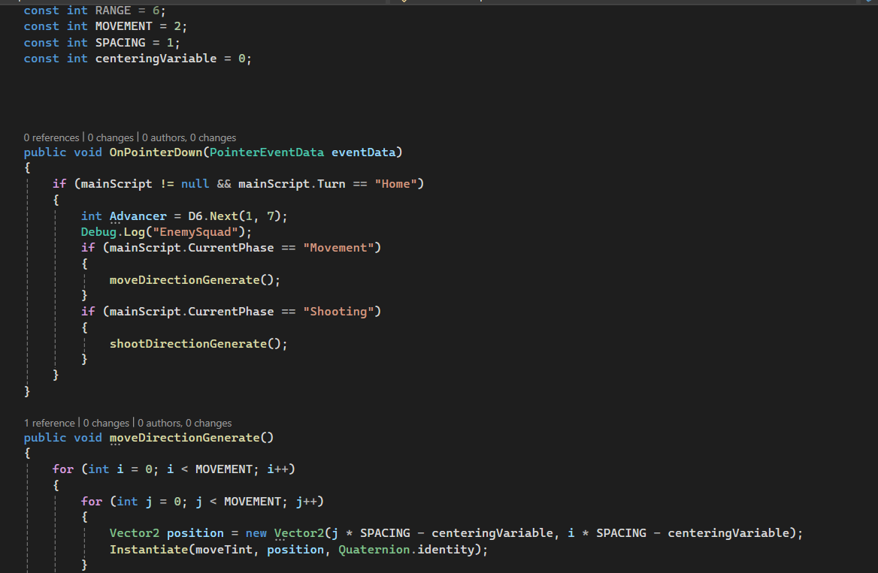
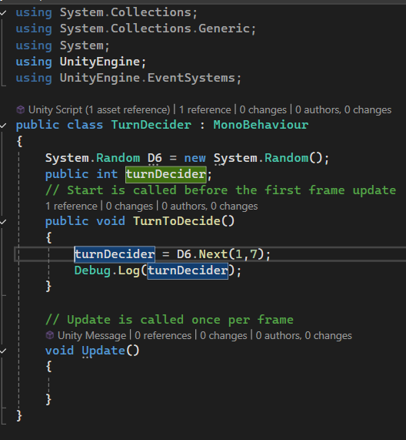
7/5/25
Today I have made quite a bit of progress. I have decided that the cover system would be too complicated for me to implement on such a short timescale with other items needing to be made. I have implemented squares that will tint the places that can be moved to.

Slide 15
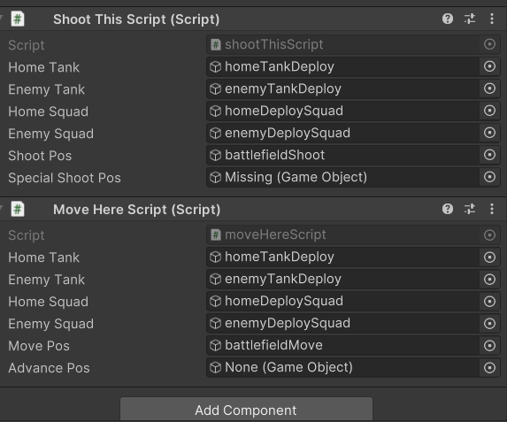
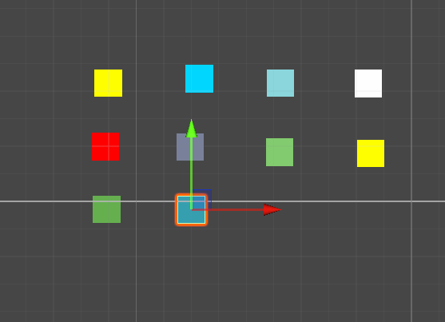
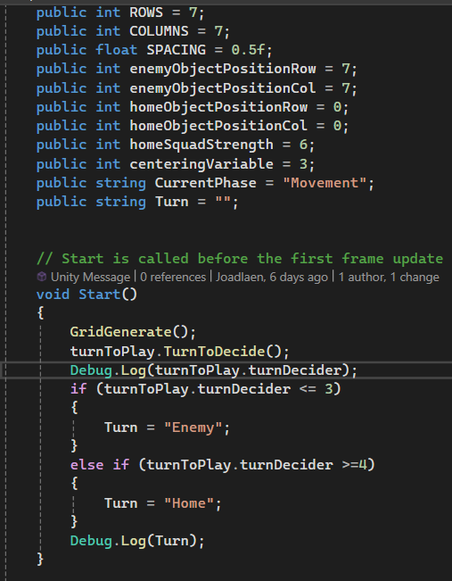
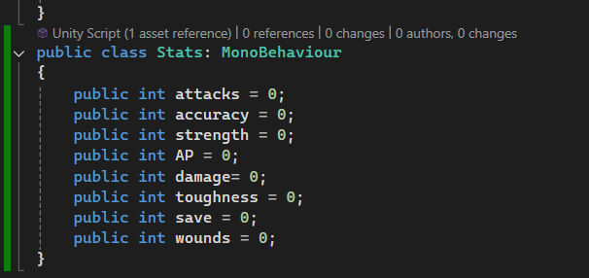
I made the movement and shoot indicators which I have called the tints. I have also assigned them to the grid manager. I have also made the advance indicators and the special shooting indicators but took the screensnips before implementing them.

Slide 16
8/5/25
Today I have improved the placing of the move tint. It now forms a plus shape instead of a square. This is the shape I am after and the

Slide 17
11/5/25
Today I have fully realised the method of movement and have a way to check for a piece in a moveable space. It involves an array that stores the positions of all movable pieces and an individual vector2 for each movable piece as well. The vector2 will store the current position and will spawn the movement indicators around them by instantiating the movement indicators around the piece and sending the vector2 of that specific piece to each movement indicator. This should then be sent back when a movement indicator is clicked. This should then remove the movement indicators around the piece. Clicking the battlefield pieces should also remove the movement and shooting indicators but it should check that it has the right ones as the asset it is instantiating is outside the visible region and outside of the grid which would be a thing to look for. I could either use a raycast from the camera or check for any instances within the grid that makes up the battlefield.
I also need to make the phases and turns system work which will have a button to change the phase and another button to change whose turn it is. This will check what turn it is now or who is currently playing and if pressed, it will remove any indicators that a piece has moved or shot and enable the scripts that allow those features. The phase or turn should prevent the wrong pieces being used or moved as the if statement on each will catch the turn being wrong or not. To add functionality to the volume button, I will also add an mp3 from incompetech.
Other than this, I need to do three other scenes to show who won and a main menu. This could be a place to add sounds and volume selectors.

Slide 18
12/5/25
Today, I have begun testing some of the features of my game. I attempted to test the objective win condition but the boxcolliders prevented the piece from coming into contact with the objective. The turn passover is working and the turn will change allowing the other players piece to instantiate the movement indicators.
I still need to get the movement indicators to work. I will probably remove the original instance of the moving piece and instantiate the piece in the chosen location. Clicking off will remove the movement indicators and instantiating thwe new piece will also remove the movement indicators. A variable will be used to say it has moved and it can be reset upon the other players movement phase. I will need to implement this.

Slide 19
13/5/25
I have done some research today and have discovered one problem with my code. I was using an OnCollission​bject for my objective while I should have been using the OnTriggerEnter function as the colliders will be occupying the same space.
I have also finished making the array today and should hopefully be able to put it into practice in the lab sessions tomorrow.

Slide 20
14/5/25
Today I finished the movement system. I implemented a variable which receives the name of the moved piece and compares it to several if statements. When the new icon is instantiated, the if statement will instantiate the new icon after removing the old icon, it will then remove the movement indicators. A button can be instantiated or simply in the collection of buttons on the side. It will remove any objects with the "movetint" or shoottint tags that are within the view of the camera. this should keep the original tints from being removed due to them being required for moving and shooting. This could be done by checking the array if it is added to the array in "main.cs" or it could be done without that functionality by using a raycast or similar. Once the movement is finished, i just need to do a similar thing for the shooting script and have the variable declare the type of attack by indicating the tank or the squad. The damage would then be done on the object in that given array position.

Slide 21
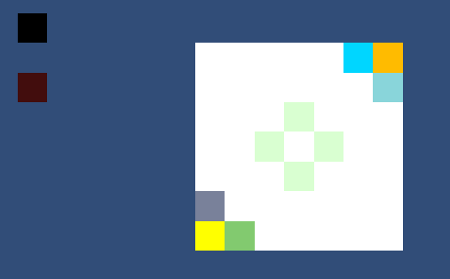

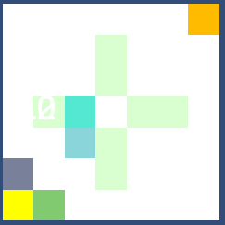
19/5/25
Today I managed to fully implement movement. My original plan which worked for a while involved destroying the object and instantiating a new object in the required position. The original object still kept the references to position so themove direction indicators spawned around the original potion. Using a function to teleport the piece to it's required position has been successful. The movement system also has a bug which, due to the time limit, I may not be able to deal with for this coursework. It is made apparent by the method for which I check the position the player wants to move to which checks for the position of the mouse. The function works well enough if the mouse is used in the top left corner. The movement indicators do despawn when the battlefield tiles are clicked, whenever the indicators are clicked and whenever the turn changer or phase changer buttons are clicked. At the present moment, the movement except for the first turn which spawns the indicators around the middle has been finished. The turn changers work but the indicators occasionally don't. Going forward, I may just have the phase changer which changes the turn automatically. It also changes the indicators while the turn changer doesn't.

Slide 22
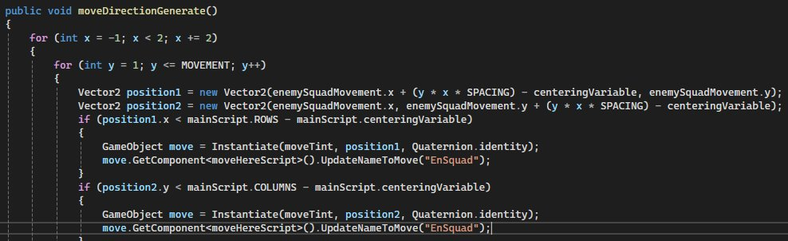
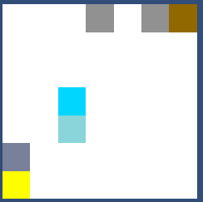
This is the Home Tank in the same position as the Enemy Objective. At this point, the end game scenario does not work. This could be done by checking that the vector2 positions are the same as the objective. This could reduce the number of scripts I have as the objectives will be handled by a single script which will check for the position of the opposite player's Tank and Squad and checking if they have the same x and y coordinates as the designated positions for the objectives.
My plan for tomorrow or even later today is to finish these items, properly design the end screens, find an mp3 file for in game music and finish the main menu. I will be adding a quit button, finish making the volume buttons and linking them to the mp3 audio source.
The end screens need to have text added to them and the home wins needs to have the backboard like the enemy wins screen.

Slide 23
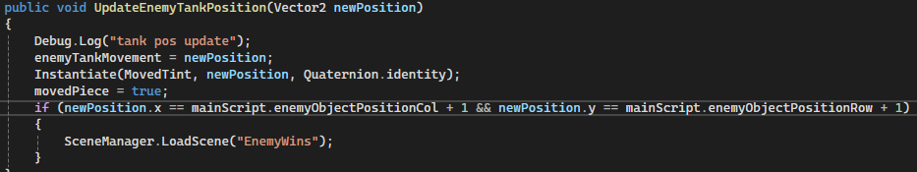
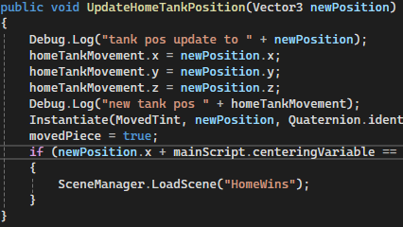
20/5/25
This is the last day I plan on working on this game so I can finalise other projects. The game has movement which is slightly buggy due to the method of movement. The fix is to recommend players click in the top right quadrant of the indicator they want to move to. Today I have implemented an end game condition and have begun to do final testing. This will simply be, can the pieces get to the other side of the board. When the piece has the same position as the objective, it will load its respective win scene. The + 1 in the image was a result of encountering a bug which loaded the scene when the object was diagonally one away from where it should have been. I will be testing with all pieces and finalising my documentation.
The end condition checker was experiencing some problems during testing which prematurely activated the enemy wins scene
Finally art the end of the day, I have a product that I am happy demonstrating.

